Slide 1
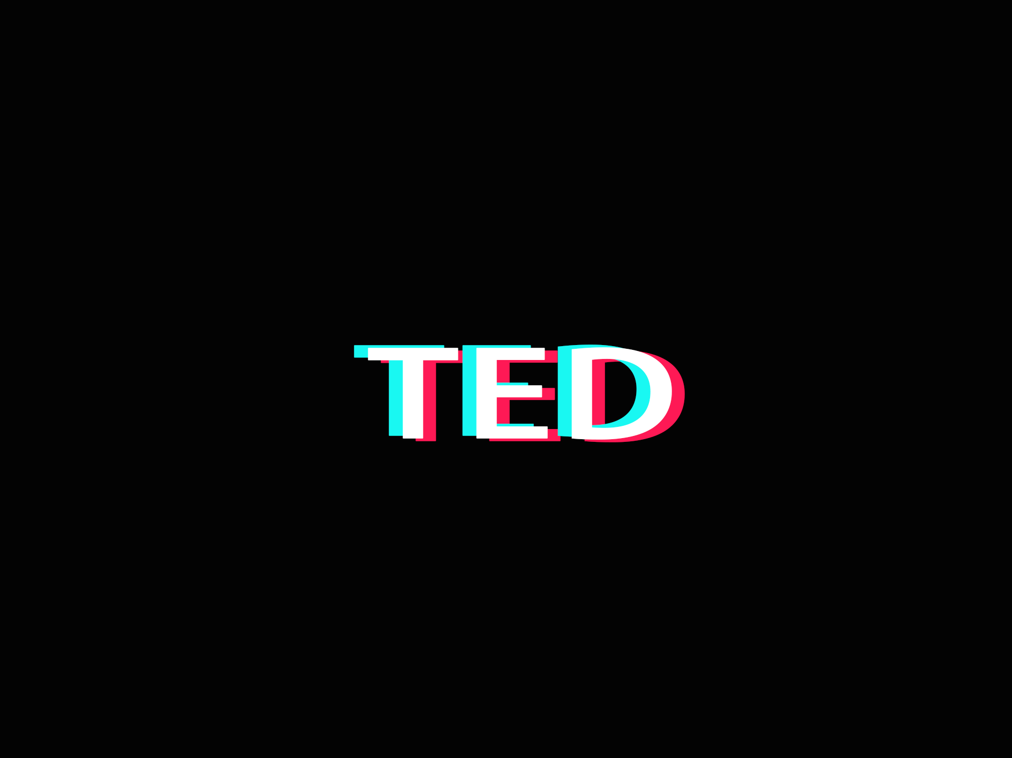
TED Talks Data Mining
—— Initialization Step
2019.5.6

Slide 2
Subtitles
2
3
4
5
1
Problem Description
Define tasks for each student
Difficulties
Context Analysis
Global Architecture

Slide 3
Problem Description & Context Analysis
We have chosen a dataset containing information about all audio-video recordings of TED Talks uploaded to the oﬃcial TED.com website until September 21st, 2017.
We want to use this dataset to start a project of data mining, ﬁnding the relationship of views, number of comments, main topics, languages and areas. In addition, we may ﬁnd a popular topics trend from last ten years and predict what will be discussed at next ﬁve years.

Slide 4
The Goals of the Application
We tend to develop an application recommending TED Talks and seeing the popular topics trend between any time period.
After register and log in our web application, users would do things as follow:
1. Choose some of the generalized topics which they are interested in.
2. Watch the recommendation from our application.
3. After watching, they may give some advice like 'I like it' and 'I do not like it'.
And they can also see the trend in diﬀerent areas and diﬀerent time periods, which will be displayed as a histogram or bar chart.

Slide 5
Global Architecture
We decide to develop a web application,
so our system contains forward-end and backward-end.
Backward-end
PRODUCT
Forward-end
Using a web framework of Python called Django to operating the data given by our data analysis program using pandas and TensorFlow.
Using the web framework called React to show data gotten from the backward-end.

Slide 6
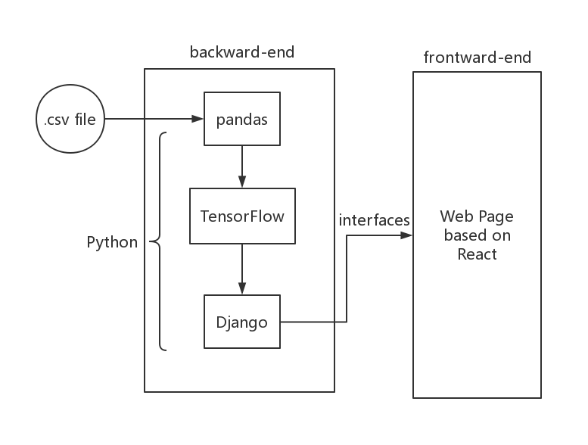
Global Architecture
We could get the architecture diagram like this:
First of all, we use a Python data processing framework called Pandas to extract the data from .csv file to a specific data format for TensorFlow.
After getting the data, we use TensorFlow to train our model and get a prediction from our data.
The result of TensorFlow will be organized by using Django and then will be sent to the web page by prescribed interfaces.

Slide 7
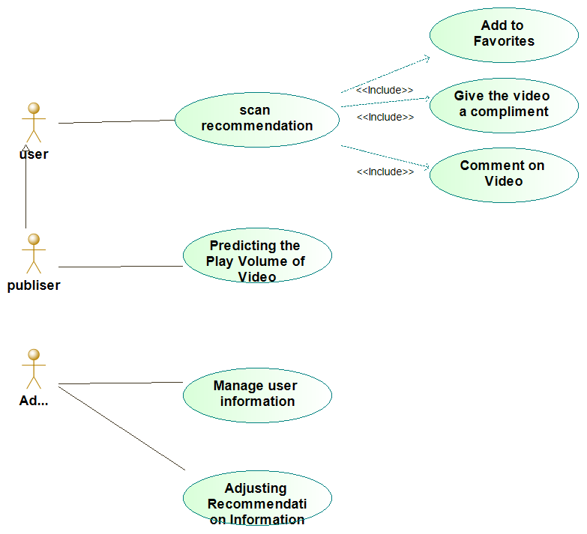
Global Architecture

Slide 8
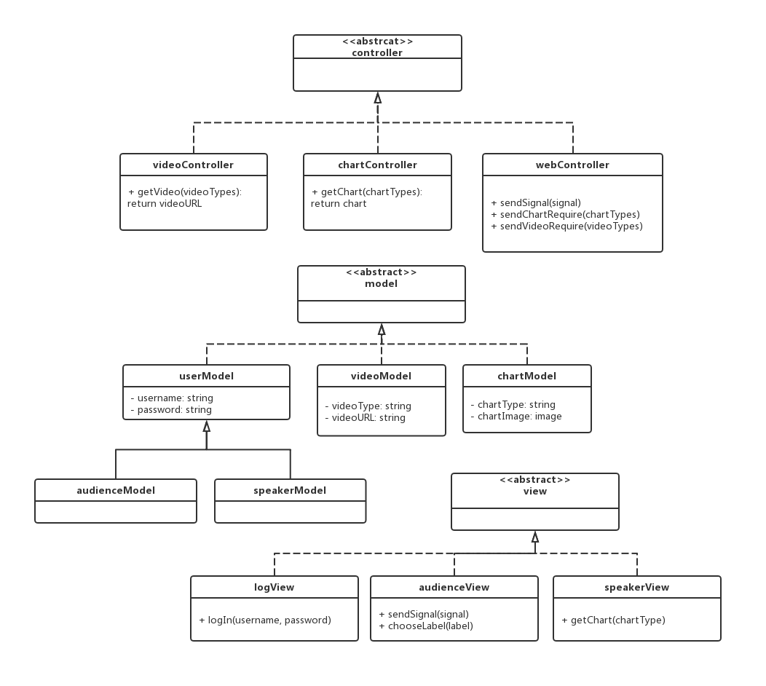
Global Architecture
The overall design follows the MVC design pattern.
We abstract users, videos, and charts into models to facilitate the exchange and delivery of data.
The front end and back end will request and pass data through their respective controllers.

Slide 9
Difficulties
We have found a obvious relationship between views and number of comments by doing a simple linear analysis, however it seems not easy for us to extract data from the 'tag', while we are attempting to ﬁnd the relationship between main topics and views.
Besides, we need to choose one or two main tags from the array of 'tag' data, which means it requires a huge amount of work to organize and label data.

Slide 10
Task Assignment
Timeline
Application
Build a
Web Page Front-end
Sui Mingben, Wang Yibo
5 ~ 6 Days
Process Data
& Train Model
Hou Qinhan
5 ~ 7 Days
Develop a
Development Plan
All of the group members
3 ~ 4 Days
Build a
Web Page Background
Wang Zhihang
5 ~ 6 Days
GO

Slide 11
Thanks for Watching

